Slide 1
Software Systems Design and Integration
Self-Study, Part I
Multimedia Networking
1-<number>

Slide 2
Lecture Plan
  Multimedia Networking
    Fundamental characteristics of MM applications
    Classification
    Compression of MM signals
  2. Streaming Stored Video
  3. Real-time Interactive Multimedia
  4. Protocols for Real Time Interactive Apps
1-<number>

Slide 3


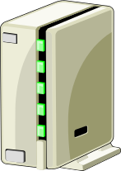

Multimedia, Quality of Service: What is it?
Multimedia applications: network audio and video
(“continuous media”)
QoS
network provides application with level of performance needed for application to function.
1-<number>

Slide 4
Fundamental characteristics of multimedia applications
Typically delay sensitive:
  end-to-end delay
  delay jitter
But loss tolerant:
  infrequent losses cause minor glitches only
  Antithesis of data, which are loss intolerant but delay tolerant.
  Jitter is the variability
  of packet delays within
  the same packet stream
  Transmission Loss is the percentage of missed packets within the same packet stream
1-<number>

Slide 5
Types of MM Networking Applications
Classes of MM applications:
1) Streaming stored audio and video (e.g., streaming)
2) Streaming live audio and video (e.g., live broadcasting)
3) Real-time interactive multimedia (i.e., interactive playing)
1-<number>

Slide 6
Streaming Stored Multimedia
Examples:
Watching movie played on YouTube, Netfilx, iPlayer, etc.
Streaming:
media stored at source
transmitted to client
client playout begins before all data has arrived
timing constraint for still-to-be transmitted data: frames must be in time for playout
Interactivity - VCR-like functionality
fast forward - possible
rewind, pause, continue - possible
1-<number>

Slide 7

Streaming Stored Multimedia:
How it works?
Cumulative data
2. video
sent
1. video
recorded
3. video received,
played out at client
network
delay
time
streaming: at this time, client
playing out early part of video,
while server still sending later
part of video
1-<number>

Slide 8
Streaming Live Multimedia
Examples:
Digital radio talk show
Digital TV live sport match
Digital CCTV camera live surveylance
Streaming (as with streaming stored multimedia)
Media not stored but live
playback buffer
playback can lag tens of seconds after transmission
still have timing constraint
Interactivity
fast forward – impossible (not going to the future!)
rewind, pause, continue – still possible
1-<number>

Slide 9
Real-Time Interactive Multimedia
Examples: IP telephony, video conferencing, live TV, interactive games (SecondLife)
End-end delay requirements:
  audio: < 150 msec good, < 400 msec OK
    includes application-level (packetisation) and network delays
    higher delays noticeable, impair interactivity
Session initialization
  how does callee advertise its IP address, port number,
  encoding algorithms?
1-<number>

Slide 10


Multimedia Over Today’s Internet
TCP/UDP/IP: no guarantees on delay, possible loss of data
But you said multimedia apps requires
QoS and level of performance to be
effective!
Today’s Internet multimedia applications
use application-level techniques to mitigate
(as best possible) effects of delay and loss
– best possible service only!
1-<number>

Slide 11
Use of audio compression to improve QoS
Analog signal sampled at constant rate
  Telephone voice: 8,000 samples/sec
  CD music: 44,100 samples/sec
Each sample quantized, i.e., rounded
  e.g., 2⁸ = 256 values, 2¹⁶ = 65536 values
Each quantized value represented by bits
  16 (standard CD), 20 bits (super-audio), 24 bits (standard DVD)
quantization error
quantized value of
analog value
analog
signal
audio signal amplitude
time
sampling rate
(N sample/sec)
Example: 8,000 samples/sec, 256 values = 64,000 bps
1-<number>

Slide 12
The choices affect quality!
  The higher the transfer rate, the higher the frequency – affects the bandwidth
  More quantization levels, better quality – affects the size of data
Example rates
  CD and lossless formats (.wav, .aiff): up to 1.411 Mbps
  Lossy video formats (.mp3, .mp4): 96kbps (lowest), 128 kbps (most .mp3 players), 256kbps (Apple iTunes .mp4)
  Internet telephony (VoIP): from 5.3 kbps and up
1-<number>

Slide 13
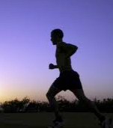
Use of videocompression to improve QoS
Video is a sequence of images at constant rate
  High-speed cameras – 50-60 frames/sec
  Human eye - max 30 frames/sec
  Often less - e.g. 24-25 images/sec for HD video
Digital image is a static array of pixels
  Each pixel represented by bits (i.e., 8 bits)
Redundancy&encoding
  spatial
  temporal
spatial coding example: instead of sending N values of same color (all purple), send only two values: color value (purple) and number of repeated values (N)
……………………...…
……………………...…
frame i
temporal coding example: instead of sending complete frame at i+1, send only differences from frame i
frame i+1

Slide 14
Methods of videocompression
Methods
CBR: (constant bit rate): video encoding rate fixed
VBR: (variable bit rate): video encoding rate changes as amount of spatial, temporal coding changes
Examples:
MPEG-1 (VHS, CD-ROM) 1.5 Mbps
MPEG-2 (DVD, Digital TV) up to 10 Mbps
MPEG-4 (Internet)
up to12 Mbps
Research:
  VBR
    Using videocompression to optimize the rate changes
Layered (scalable) video
  Automatically adapting the layers to the bandwidth
1-<number>

Slide 15
Lecture Plan
  1. Multimedia Networking Applications
  2. Streaming Stored Video
    UDP vs. TCP
    RTSP
    DASH
  3. Real-time Interactive Multimedia
  4. Protocols for Real Time Interactive Apps
1-<number>

Slide 16
Streaming Stored Multimedia
Application-level streaming techniques for making the best out of best effort service:
  client side buffering
  use of UDP versus TCP
  multiple encodings of multimedia signal
Media Player
jitter removal
decompression
error concealment
graphical user interface
w/controls for interactivity
1-<number>

Slide 17
Streaming Live Multimedia:
UDP or TCP?
UDP
server sends at rate appropriate for client (oblivious to network congestion!)
  often send rate = encoding rate = constant rate
  then, fill rate = constant rate - packet loss
short playout delay to compensate for network jitter
error recovery: time permitting
TCP
send at maximum possible rate under TCP
fill rate fluctuates due to TCP congestion control
larger playout delay: smooth TCP delivery rate
HTTP
passes more easily through firewalls
1-<number>

Slide 18

Streaming Multimedia: client rate(s)
1.5 Mbps encoding
28.8 Kbps encoding
Q: how to handle different client receive rate capabilities?
  28.8 Kbps dialup
  100Mbps Ethernet
A: server stores, transmits multiple copies of video, encoded at different rate/frequency
1-<number>

Slide 19
User Control of Streaming Media: RTSP
What it is:
Real-time Streaming Protocol (RFC 2326)
Client-server, application layer protocol.
Commands for user to control display: rewind, fast forward, pause, resume, reposition, etc…
What it doesn’t do:
does not define how audio/video is encapsulated for streaming over network
does not restrict how streamed media is transported; it can be transported over UDP or TCP
does not specify how the media player buffers audio/video
1-<number>

Slide 20
RTSP: out of band control
RTSP uses an “out-of-band” control channel like FTP:
A file is transferred over one TCP connection.
Control information (directory changes, file deletion, file renaming, etc.) is sent over a separate session which uses TCP or UDP.
The “out-of-band” and “in-band” channels use different port numbers.
RTSP messages are also sent out-of-band:
RTSP signal uses standard channel (“in-band” media stream).
  Port 1755
RTSP control messages use different port than the “in-band” media stream (“out-of-band” stream).
  Port 554
1-<number>

Slide 21
RTSP Example
Scenario:
metafile communicated to web browser
browser launches player
player sets up an RTSP control connection and standard data connection to streaming server
player plays the videostream “in-bound”
player processes control commands “out-of-bound”
1-<number>

Slide 22
Metafile Example
<title>Twister</title>
<session>
<group language=en lipsync>
<switch>
<track type=audio
e="PCMU/8000/1"
src = "rtsp://audio.example.com/twister/audio.en/lofi">
<track type=audio
e="DVI4/16000/2" pt="90 DVI4/8000/1"
src="rtsp://audio.example.com/twister/audio.en/hifi">
</switch>
<track type="video/jpeg"
src="rtsp://video.example.com/twister/video">
</group>
</session>
1-<number>

Slide 23
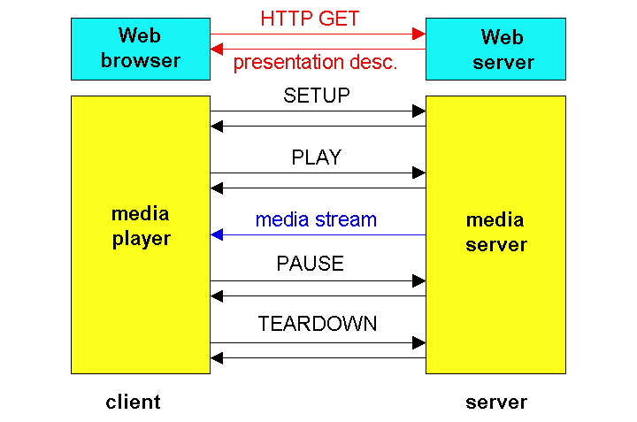
RTSP Operation
1-<number>

Slide 24
RTSP Exchange Example
C: SETUP rtsp://audio.example.com/twister/audio RTSP/1.0
Transport: rtp/udp; compression; port=1755; mode=PLAY
S: RTSP/1.0 200 1 OK
Session 4231
C: PLAY rtsp://audio.example.com/twister/audio.en/lofi RTSP/1.0
Session: 4231
Range: npt=0-
C: PAUSE rtsp://audio.example.com/twister/audio.en/lofi RTSP/1.0
Session: 4231
Range: npt=37
C: TEARDOWN rtsp://audio.example.com/twister/audio.en/lofi RTSP/1.0
Session: 4231
S: 200 3 OK
1-<number>

Slide 25
Streaming Multimedia: DASH
DASH: Dynamic, Adaptive Streaming over HTTP
server:
  divides video file into multiple chunks
  each chunk stored, encoded at different rates
  manifest file: provides URLs for different chunks
client:
  periodically measures server-to-client bandwidth
  consulting manifest, requests one chunk at a time
    chooses maximum coding rate sustainable given current bandwidth
    can choose different coding rates at different points in time (depending on available bandwidth at time)

Slide 26
(cont.)
“intelligence” at client: client determines
  when to request chunk (so that buffer starvation, or overflow does not occur)
  what encoding rate to request (higher quality when more bandwidth available)
  where to request chunk (can request from URL server that is “close” to client or has high available bandwidth)

Slide 27
Lecture Plan
  1. Multimedia Networking Applications
  2. Streaming Stored Video
  3. Real-time Interactive Multimedia
    Types of real-time MM applications
    Losses, Delays and Recovery
  4. Protocols for Real Time Interactive Apps
1-<number>

Slide 28
Types of real-time interactive applications
PC-2-PC
  Skype
PC-2-phone
  Yahoo! Voice
  Net2phone
  Skype
Phone-2-phone
  Viber
  Whatsapp
We will now look at a PC-2-PC Internet phone example in detail
1-<number>

Slide 29
Interactive Multimedia: Internet Phone
Introduce Internet Phone by way of an example
speaker’s audio: alternating talk spurts, silent periods.
  64 kbps during talk spurt
pakets generated only during talk spurts
  20 msec chunks at 8 Kbytes/sec: 160 bytes data
application-layer header added to each chunk.
Chunk+header encapsulated into UDP segment.
application sends UDP segment into socket every 20 msec during talkspurt.
1-<number>

Slide 30
Packet Loss and Delay
network loss: IP datagram lost due to network congestion (router buffer overflow)
delay loss: IP datagram arrives too late for playout at receiver
  delays: processing, queueing in network; end-system (sender, receiver) delays
  typical maximum tolerable delay: 400 ms
loss tolerance: depending on voice encoding, losses concealed, packet loss rates between 1% and 10% can be tolerated.
1-<number>

Slide 31
Delay Jitter
constant bit
rate
transmission
client
reception
constant bit
rate playout
at client
Cumulative data
variable
network
delay
(jitter)
buffered
data
client playout
delay
time
Consider the end-to-end delays of two consecutive packets: difference can be more or less than 20 msec
1-<number>

Slide 32
Recovery from packet loss
Forward Error Correction (FEC): simple scheme
for every group of n chunks create a redundant chunk by exclusive OR-ing the n original chunks
send out n+1 chunks, increasing the bandwidth by factor 1/n.
can reconstruct the original n chunks if there is at most one lost chunk from the n+1 chunks
Playout delay needs to be fixed to the time to receive all n+1 packets
Tradeoff:
  increase n, less bandwidth waste
  increase n, longer playout delay
  increase n, higher probability that 2 or more chunks will be lost
1-<number>

Slide 33
Lecture Plan
  1. Multimedia Networking Applications
  2. Streaming Stored Video
  3. Real-time Interactive Multimedia
  4. Protocols for Real Time Interactive Apps
    RTP
    RTCP
1-<number>

Slide 34
Real-Time Protocol (RTP)
RTP specifies a packet structure for packets carrying audio and video data (RFC 3550).
RTP packet provides
  payload type identification
  packet sequence numbering
  timestamping
RTP runs in the end systems.
RTP packets are encapsulated in UDP segments
Interoperability: If two Internet phone applications run RTP, then they may be able to work together
1-<number>

Slide 35
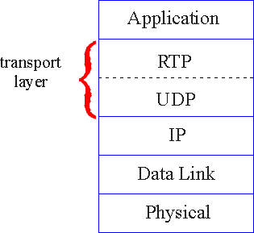
RTP Protocol Layer
RTP libraries provide a transport-layer interface
that extend UDP:
  port numbers, IP addresses
  payload type identification
  packet sequence numbering
  time-stamping
1-<number>

Slide 36
RTP Example
Consider sending 64 kbps PCM-encoded voice over RTP.
Application collects the encoded data in chunks, e.g., every 20 msec = 160 bytes in a chunk.
The audio chunk along with the RTP header form the RTP packet, which is encapsulated into a UDP segment.
RTP header indicates type of audio encoding in each packet
  sender can change encoding during a conference.
RTP header also contains sequence numbers and timestamps.
1-<number>

Slide 37
RTP and QoS
RTP does not provide any mechanism to ensure timely delivery of data or provide other quality of service guarantees.
RTP encapsulation is only seen at the end systems: it is not seen by intermediate routers.
  Routers providing best-effort service do not make any special effort to ensure that RTP packets arrive at the destination in a timely matter.
1-<number>

Slide 38
Real-Time Control Protocol (RTCP)
Works in conjunction with RTP.
Each participant in RTP session periodically transmits RTCP control packets to all other participants.
Each RTCP packet contains sender and/or receiver reports
  report statistics useful to application - number of packets sent, number of packets lost, inter-arrival jitter, etc.
  feedback can be used to control performance - sender may modify its transmissions based on feedback
1-<number>

Slide 39
RTCP Packets
Receiver report packets:
fraction of packets lost, last sequence number, average interarrival jitter.
Sender report packets:
Synchronization source identifier (SSRC) of the RTP stream, the current time, the number of packets sent, and the no. of bytes sent.
Source description packets:
e-mail address of sender, sender's name, SSRC of associated RTP stream.
Provide mapping between SSRC and user/host name.
1-<number>

Slide 40
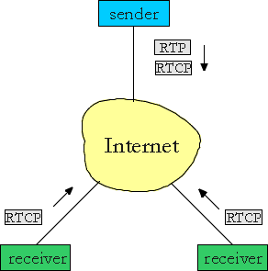
RTCP Multicasting
For an RTP session there is typically a single multicast address; all RTP and RTCP packets belonging to the session use the multicast address.
RTP and RTCP packets are distinguished from each other through use of distinct port no’s.
To limit traffic, each participant reduces his RTCP traffic as the number of conference participants increases.
1-<number>

Slide 41
RTCP Stream Synchronisation
RTCP can synchronize different media streams within an RTP session.
  Consider videoconferencing app for which each sender generates one RTP stream for video and one for audio.
  Timestamps in RTP packets tied to the video and audio sampling clocks, not tied to the wall-clock time
Each RTCP sender-report packet contains (for the most recently generated packet in the associated RTP stream):
  timestamp of the RTP packet
  wall-clock time for when packet was created.
Receivers can use this association to synchronize the playout of audio and video.
1-<number>

Slide 42
RTCP Bandwidth Scaling
RTCP tries to limit its traffic to 5% of session bandwidth.
Example
Suppose one sender, sending video at a rate of 2 Mbps. Then RTCP attempts to limit its traffic to 100 Kbps.
RTCP gives 75% of this rate to the receivers; remaining 25% to the sender
The 75 kbps is equally shared among receivers:
  R receivers, each receiver sends RTCP traffic at 75/R kbps.
Sender gets to send RTCP traffic at 25 kbps.
Participant determines RTCP packet transmission period by calculating avg RTCP packet size (across session) and dividing by allocated rate.
1-<number>

Slide 43
Summary:
Internet Multimedia - bag of tricks
use UDP to avoid TCP congestion (data) and HTTP for meta-data to avoid firewalls (control)
client-side adaptive playout delay: to compensate for delay and jitter
server side matches stream bandwidth to available client-to-server path bandwidth
  chose among pre-encoded stream rates
  dynamic server encoding rate
error recovery (on top of UDP)
  interleaving (data specific)
  retransmissions(time permitting)
  conceal errors by repeat nearby data
1-<number>

